Slide 1

Session 7 – Python Extending the Snake

Slide 2

Extending the Snake
More Types
Furthering the Collective
Improved Logic and Error Handling
List Comprehensions
Lambda Expressions
Classes in Python
Keyword Arguments
GUI’s
Creating Executables

Slide 3

Extending the Snake
More types
Complex Numbers
complex(real,complex)
z=complex(3,4)
j as complex variable name
Z=3+4j = complex(3,4)
conjugate()
Complex conjugate
z.conjugate() = 3-4j

Slide 4
Extending the Snake
Furthering the Collective
# Methods and Properties of collections
List
Dictionaries
Sets
# Slice notation
a[start:end] # items start through end-1
a[start:] # items start through the rest of the array
a[:end] # items from the beginning through end-1
a[:] # a copy of the whole array

Slide 5
Extending the Snake
Furthering the Collective
Methods for lists, tuples, and dictionaries
min(x)
Get the element that has the minimum value in x
max(x)
Get element that has the maximum value in x
len(x)
Number of elements in x
Can also get the number of characters in a string

Slide 6
Extending the Snake
Furthering the Collective
Methods for lists
example_list.pop()
Remove and output the last element in the list
example_list.append(val)
Add val as a new element to the end of example_list
example_list.reverse()
Invert the relative location of each element in example list
See more in the docs
https://docs.python.org/3/library/stdtypes.html

Slide 7
Extending the Snake
Furthering the Collective
Slice notation to access elements
a[start:end] # items start through end-1
a[start:] # items start through the rest of the array
a[:end] # items from the beginning through end-1
a[:] # a copy of the whole array

Slide 8

Extending the Snake
Furthering the Collective
set
Set with {}
Creates distinct unordered pair
No indexing available
Removes any duplicates input into the set

Slide 9

Extending the Snake
Furthering the Collective
set
Can convert to list to use elements
Notice change in order from the first list once the set is converted back to a list

Slide 10
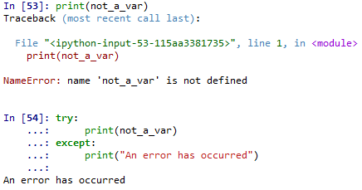
Extending the Snake
Improved Logic and Error Handling
Try-Except
Error handling

Slide 11
Extending the Snake
Improved Logic and Error Handling
Try-Except
Syntax
try:
<code statements to try>
except <error_type_1>:
<code when error type occurs>
except <error_type_2> as err:
<code when error type occurs, aliased as “Err”>
except:
<code that catches all other errors>

Slide 12

Extending the Snake
Improved Logic and Error Handling
Try-Except
Can catch all errors without specifying an exception

Slide 13

Extending the Snake
Improved Logic and Error Handling
Try-Except
Can catch specific types of errors by defining the exception

Slide 14
Extending the Snake
Improved Logic and Error Handling
Exception Types
https://docs.python.org/3/library/exceptions.html
NameError – Undefined variable

Slide 15
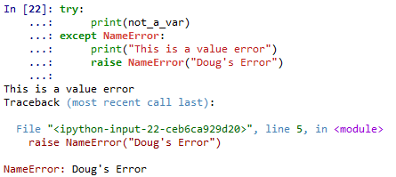
Extending the Snake
Improved Logic and Error Handling
Naming Errors
raise NameError(<error_name>)

Slide 16
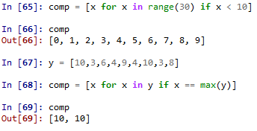
Extending the Snake
List Comprehensions
A better loop
Combine with conditionals

Slide 17

Extending the Snake
List Comprehensions
Example – Get specific values in a dictionary

Slide 18
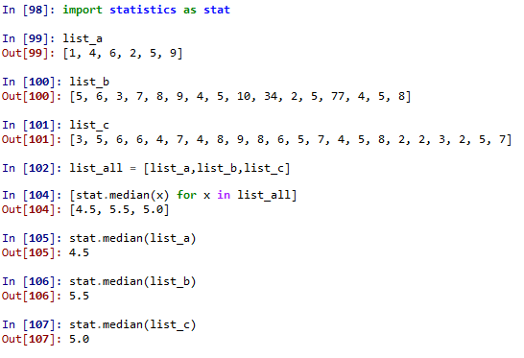
Extending the Snake
List Comprehensions
Example – get median of a list of lists

Slide 19

Extending the Snake
List Comprehensions
Nested list comprehensions
Example – get even numbers between 10 and 30

Slide 20
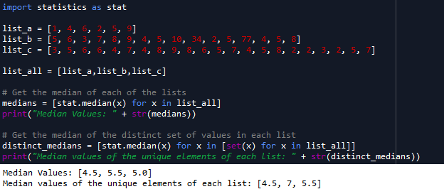
Extending the Snake
List Comprehensions
Can nest list comprehensions
Example – get medians of sets of values, and medians of the unique set of the same values

Slide 21
Extending the Snake
Lambda Expressions
Anonymous functions
a.k.a inline function
Very useful in Pandas

Slide 22

Extending the Snake
Lambda Expressions
lambda <dummy_var>: <statement using dummy var>

Slide 23
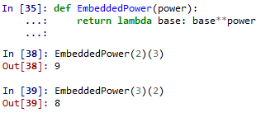
Extending the Snake
Lambda Expressions
Embedded function

Slide 24

Quiz
Define:
List Comprehensions
Sets
Slice notation
Lambda expressions
List some error handling constructs in Python

Slide 25
Quiz
Objects
Quick definition
What 3 basic items define an object
Are classes needed to program?
Are classes needed to program well?
What are some things classes good for

Slide 26
Quiz Answers
List Comprehensions
Combination of a for loop and possible conditional statements in one statement
Sets
Unique, unordered set of values
Convertible to list if order/editing is needed

Slide 27
Quiz Answers
Slice notation
Allows quick access to sections of collections
Lambda expressions
In-line, anonymous functions aliasable to a variable name
Usable in standard functions
Requires additional argument list

Slide 28
Quiz Answers
List some error handling constructs in Python
Try-Except Statement
Allows attempted code execution
Code in try section will run
If failure occurs, execution immediately breaks to Except section

Slide 29
Quiz Answers
List some error handling constructs in Python
Exceptions
Can create an Except section for each type of exception
Raise
Raises an exception with a custom name

Slide 30
Quiz
Objects
Quick definition
Organizational construct that contains related properties, methods, and hierarchy/inheritance
Ability to control access and reuse (access modifiers)
Allows the creation of user-defined datatypes
Reference types are created from classes
What 3 basic items define an object
Identity
State
Behavior

Slide 31
Quiz
Objects
Are classes needed to program?
No
Are classes needed to program well?
No

Slide 32
Quiz
Objects
What are some things classes good for
Organization
Access control
Code reuse
Breaking up code into easily testable, easily understandable sections
Easy maintenance

Slide 33
Extending the Snake
Classes in Python
Quick Review of Classes
Note: This quick review is the general case of classes. Python has some idiosyncrasies that will be discussed later

Slide 34
Extending the Snake
Classes in Python
Quick Review of Classes
ID – Constructor, variable name, memory location(s)
State – Properties/Fields
Behavior - Methods

Slide 35
Extending the Snake
Classes in Python
Quick Review of Classes
Static – One class only
Example – ‘random’ class in Python
Dynamic/Instance – Objects created for each instance
Any primitive variable (string, int, etc)
Dictionaries
Lists

Slide 36
Extending the Snake
Classes in Python
Quick Review of Classes
Access
Can set members’ access levels
public
private
protected
internal
Note: This is not enforced in Python—all members are public

Slide 37
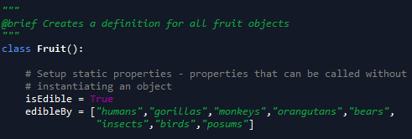

Extending the Snake
Classes in Python
Static Properties
Callable without creating an object from the class
Defined before the constructor
Similar to how properties defined in C#

Slide 38
Extending the Snake
Classes in Python
Object Properties
Defined anywhere in a function/constructor
Use the “self” keyword to differentiate from static properties

Slide 39
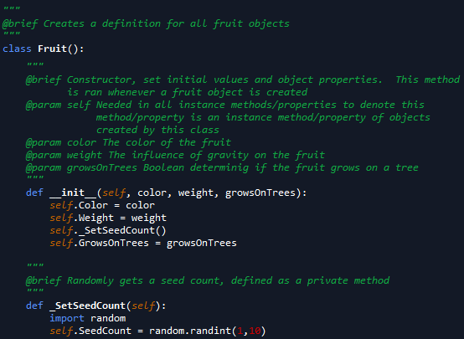

Extending the Snake
Classes in Python
Object Properties

Slide 40
Extending the Snake
Classes in Python
Object Properties
Notice scope difference in previous example
“self” keyword indicates object property
Not a local variable of _SetSeedCount(self)
Attempting to access SeedCount without “self” gives error
Why is this?

Slide 41
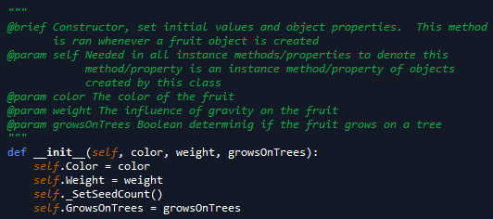
Extending the Snake
Classes in Python
Constructor
Initialization method
Always has “self” as a parameter
Always “def __init__(self,<list_of_parameters>)”

Slide 42
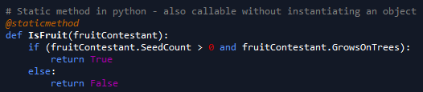

Extending the Snake
Classes in Python
Methods
All functions other than constructor in the class
Static methods have decorator precursor @staticmethod

Slide 43
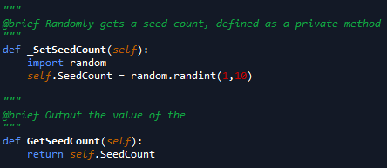

Extending the Snake
Classes in Python
Methods
Instance methods defined as a normal function
Always has “self” as a parameter

Slide 44
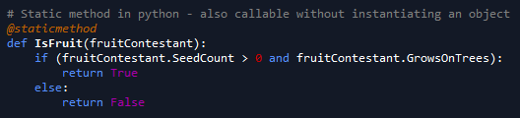
Extending the Snake
Classes in Python
Methods
Static Method Example

Slide 45
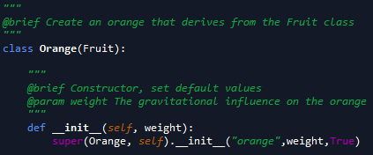
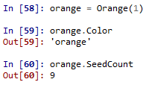
Extending the Snake
Classes in Python
Inheritance
Ability for one class to use properties and methods of its parent class

Slide 46
Extending the Snake
Classes in Python
Inheritance
super() used to call parent methods/get parent properties in the child object

Slide 47
Extending the Snake
Classes in Python
Access Control in Python
Honor system
Private fields, properties, and methods start with an underscore
“_internal_var”
“def _internal_method():”

Slide 48
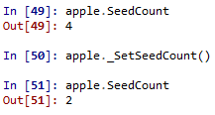
Extending the Snake
Classes in Python
Access Control in Python
Notice lack of prevention of using “private” methods

Slide 49
Extending the Snake
Classes in Python
Abstract Classes
Cannot create types from this class
A class intended only to be inherited from
Will go over more in C# due to ease of understanding code

Slide 50
Extending the Snake
Classes in Python
Example Day
Code Design
Unified Modeling Language (UML)
Block diagrams of members of classes
Methods
Properties
Fields

Slide 51
Extending the Snake
Classes in Python
Examples Premade
Helper class
Helper Class for Math
Examples Created In Class
Animal → Mammal → Cat
Food → Meat → Steak

Slide 52
Extending the Snake
Positional and Keyword Arguments
Defines order of how arguments are passed to functions/methods
Just like passing values in command line languages like PowerShell and bash

Slide 53
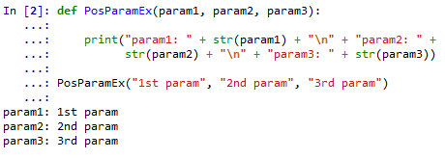
Extending the Snake
Positional and Keyword Arguments
Positional Argument
Arguments passed in the order of the parameters
If order is not maintained, errors will occur

Slide 54
Extending the Snake
Positional and Keyword Arguments
Keyword Arguments
Argument preceded by an identifier
Must be used with default parameters
Order does not need to match parameter order

Slide 55
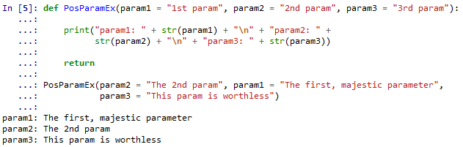
Extending the Snake
Positional and Keyword Arguments
Keyword Arguments
Notice the argument order of the function call

Slide 56
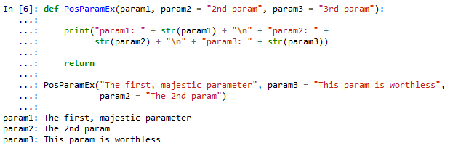
Extending the Snake
Positional and Keyword Arguments
Can combine both
Positional parameters must occur first

Slide 57
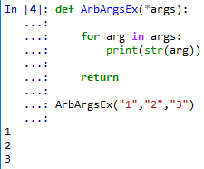
Extending the Snake
Arbitrary Argument Lists
List of arguments without formal parameters in methods/functions
Denoted by parameter “*<param_name>”
Typically denoted by “*args”
Can use any name, such as “*list_of_stuff”

Slide 58
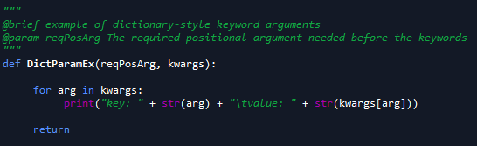

Extending the Snake
Keyword Dictionaries
Similar to arbitrary arguments, but parameters are a dictionary
Uses syntax “**<dict_name>”
Typically, named “**kwargs” or “**keywords”

Slide 59
LICENSE
Copyright 2018 Douglas Bowman
Permission is hereby granted, free of charge, to any person obtaining a copy of this software and associated documentation files (the "Software"), to deal in the Software without restriction, including without limitation the rights to use, copy, modify, merge, publish, distribute, sublicense, and/or sell copies of the Software, and to permit persons to whom the Software is furnished to do so, subject to the following conditions:
The above copyright notice and this permission notice shall be included in all copies or substantial portions of the Software.
THE SOFTWARE IS PROVIDED "AS IS", WITHOUT WARRANTY OF ANY KIND, EXPRESS OR IMPLIED, INCLUDING BUT NOT LIMITED TO THE WARRANTIES OF MERCHANTABILITY, FITNESS FOR A PARTICULAR PURPOSE AND NONINFRINGEMENT. IN NO EVENT SHALL THE AUTHORS OR COPYRIGHT HOLDERS BE LIABLE FOR ANY CLAIM, DAMAGES OR OTHER LIABILITY, WHETHER IN AN ACTION OF CONTRACT, TORT OR OTHERWISE, ARISING FROM, OUT OF OR IN CONNECTION WITH THE SOFTWARE OR THE USE OR OTHER DEALINGS IN THE SOFTWARE.

